Slide 1
Medico Medicine Database
By Andrew Kerr and Abdulla Aldhaheri

Slide 2
What is Medico?
A database to store Medicine
Gives a place to add medicines that are prescribed to the users
Gives the capability to add medicines of the users, update the prescription order, and delete medicine
Lets customers view what medicines they have ordered

Slide 3
Target Audience
Drug Stores that are privately owned/smaller than other stores like CVS and Walgreens
Users who order prescriptions from these stores

Slide 4
Drug Stores
Drug stores are the locations that the users receive their prescriptions from
Drug stores have specific locations which are based on the location such as Towson
There can not be more than one drug store in a location
The drug store table also stores the phone number and the state in which the store resides

Slide 5
Users
There are two different types of users. The Customers and the Administrators
The customers get prescribed medicine
The customers have the accessibility to view the medicines under their name
The administrators can manage everything in the medicine and customer tables
When the user orders medicine, the administrator goes in and adds the medicine under their name

Slide 6
Business Process
The Drug Stores will receive the prescriptions from the doctors when they are ordered
The Drug Store will add the prescriptions to the database
This will create simplicity for tracking prescriptions
It will track when the order is set to be picked up, what doctor submits the order, and patient information

Slide 7
User Requirement
The customer will be able to view their orders
The customer will be able to update their account information
The administrator will be able to add medicines
The administrator will be able to update medicines
The administrator will be able to delete medicines
The administrator will be able to delete customers

Slide 8
Application Requirements
Compiler that supports PHP, in this case we used Sublime
MySQL
XAMPP
MySQL Workbench

Slide 9
Language and Architecture Used
We used PHP and HTML in order to implement our application.
We used three layer architecture so that user can only interact with
the interface.
By this user cannot have access to our database directly.
Code can be easily used in other applications as well.
Code can be ported as well.

Slide 10
Future
Adding functionality for Doctors
Creating a cleaner User Interface
Making the PHP Pages more efficient

Slide 11
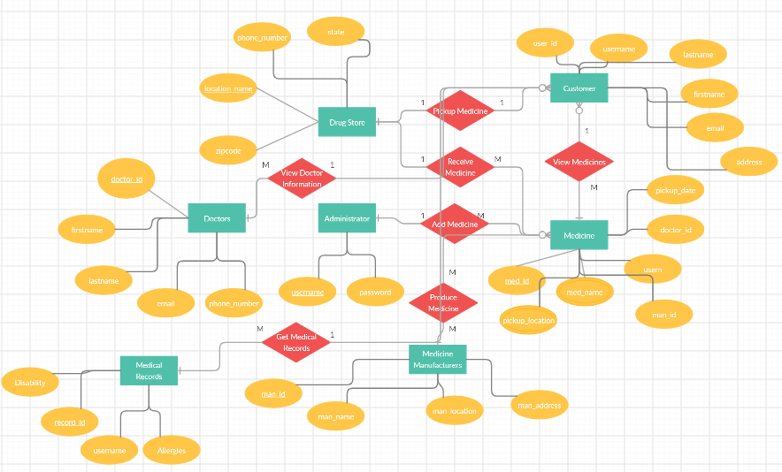
ER Diagram

Slide 12
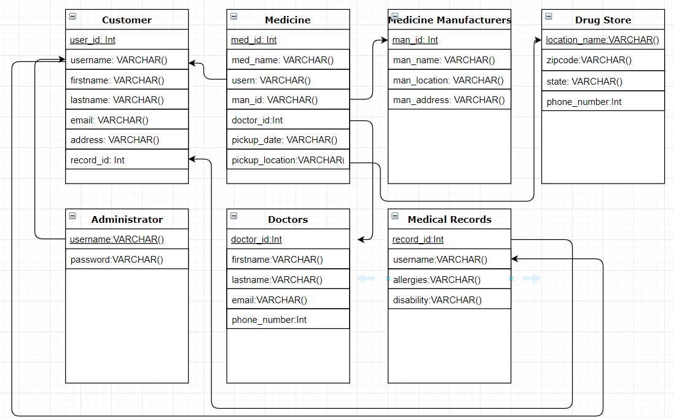
Schema

